Slide 1
Machine Learning Steps
Session2
Aakash Goel , https://www.linkedin.com/in/goelaakash123/
Acknowledgment: Presentation developed by Prof. Arun. and Modified by Aakash Goel

Slide 2
Agenda
1
Machine Learning Algorithms
2
Steps
3
Case study

Slide 3

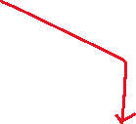




















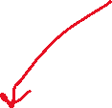















Slide 4















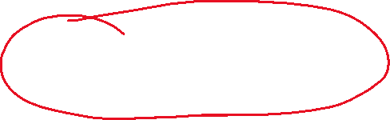

































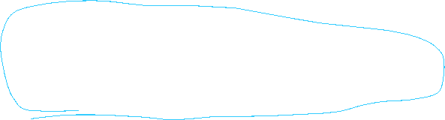

Slide 5

Machine Learning Algorithms

Slide 6
Machine learning algorithms
Key Machine Learning Algorithms
Linear Regression
Polynomial Regression
Decision Trees
Random Forests
Support Vector Machines (SVMs)
K-Means Clustering
Supervised Learning:
Linear Regression
Polynomial Regression
Decision Trees
Random Forests
Support Vector Machines (SVMs)
Unsupervised Learning:
K-Means Clustering
Notes:
https://towardsdatascience.com/how-big-is-big-data-3fb14d5351ba https://www.mckinsey.com/industries/metals-and-mining/how-we-help-clients/how-a-steel-plant-in-india-tapped-the-value-of-data-and-won-global-acclaim#/

Slide 7
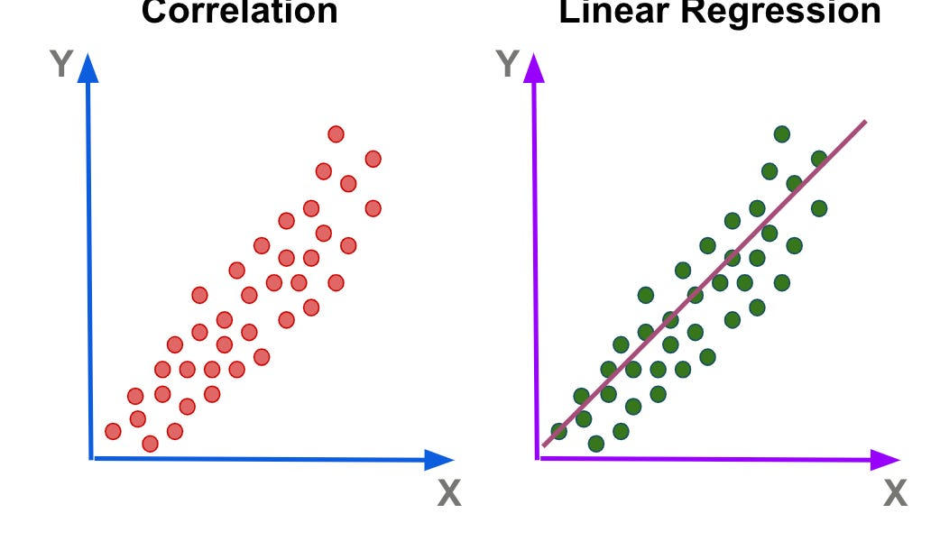

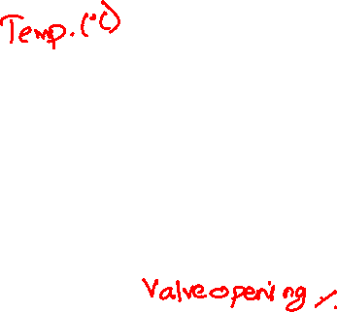
Algorithms : Linear regression
Description:
Models the relationship between a dependent variable and one or more independent variables.
Example:
Predicting material stress based on applied load.
Equation:
Notes:
https://towardsdatascience.com/how-big-is-big-data-3fb14d5351ba https://www.mckinsey.com/industries/metals-and-mining/how-we-help-clients/how-a-steel-plant-in-india-tapped-the-value-of-data-and-won-global-acclaim#/

Slide 8






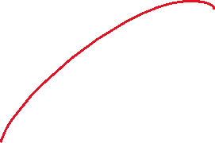







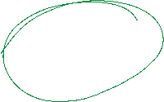













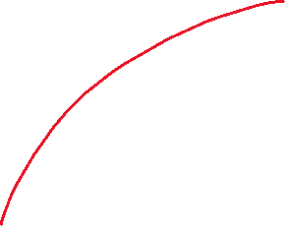







Slide 9













Slide 10
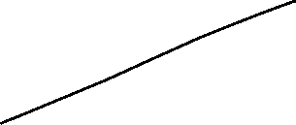

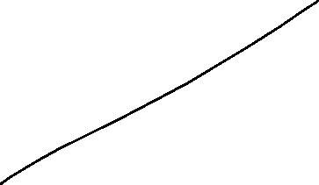

Slide 11
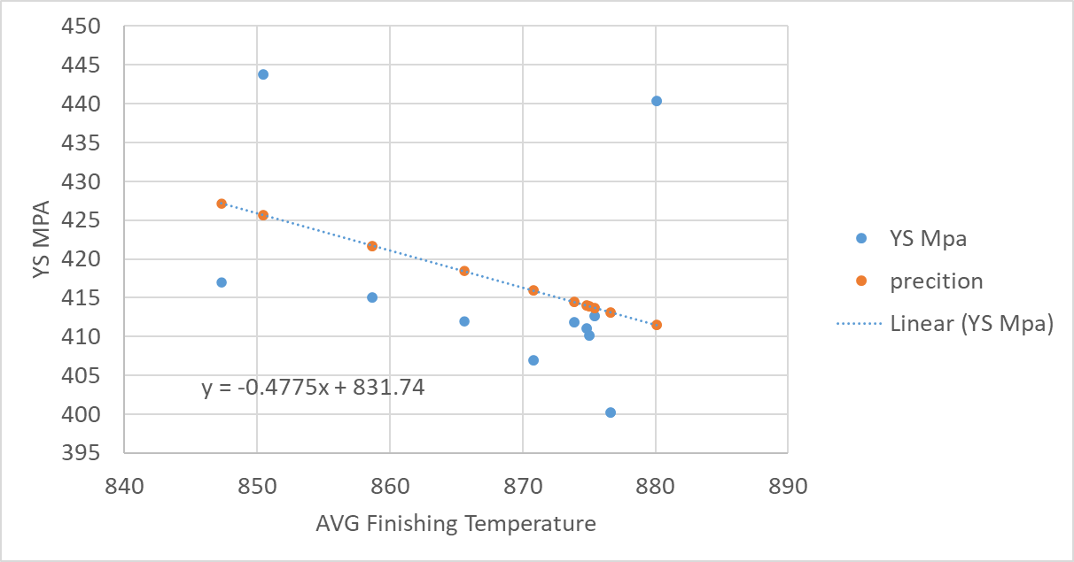


Prediction

Slide 12
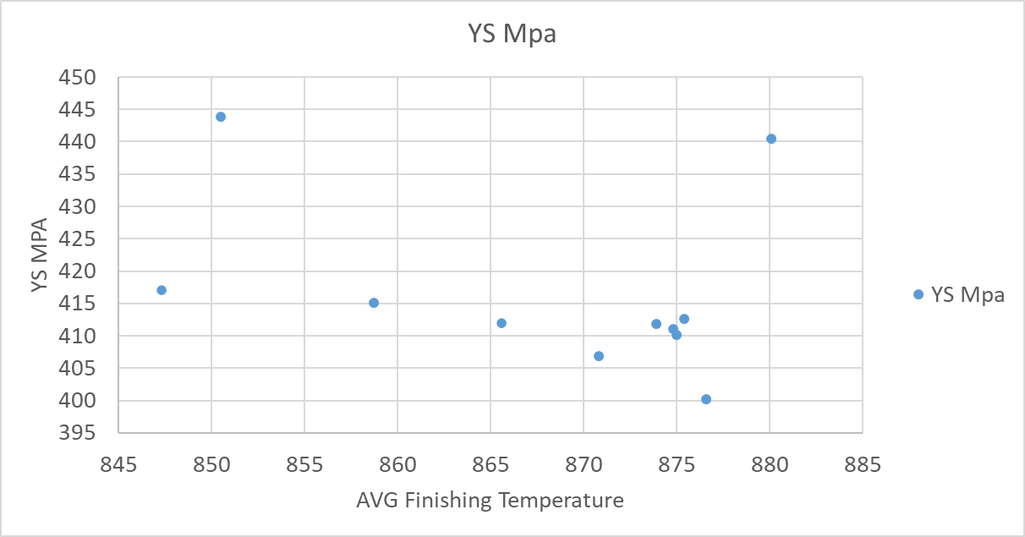

Slide 15

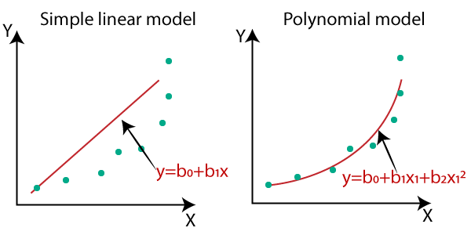
Algorithms
Polynomial Regression
Description:
Extends linear regression by adding polynomial terms to the model.
Example:
Predicting wear and tear on machinery over time
Notes:
https://towardsdatascience.com/how-big-is-big-data-3fb14d5351ba https://www.mckinsey.com/industries/metals-and-mining/how-we-help-clients/how-a-steel-plant-in-india-tapped-the-value-of-data-and-won-global-acclaim#/

Slide 16
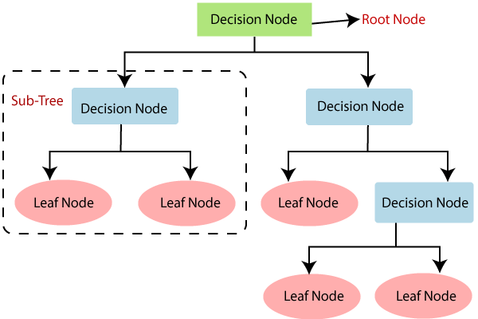
Algorithms
Decision Trees
Description:
A tree-like model for classification and regression. Splits data into branches to make predictions.
Example:
Classifying defects in manufacturing processes.
Notes:
https://towardsdatascience.com/how-big-is-big-data-3fb14d5351ba https://www.mckinsey.com/industries/metals-and-mining/how-we-help-clients/how-a-steel-plant-in-india-tapped-the-value-of-data-and-won-global-acclaim#/

Slide 18
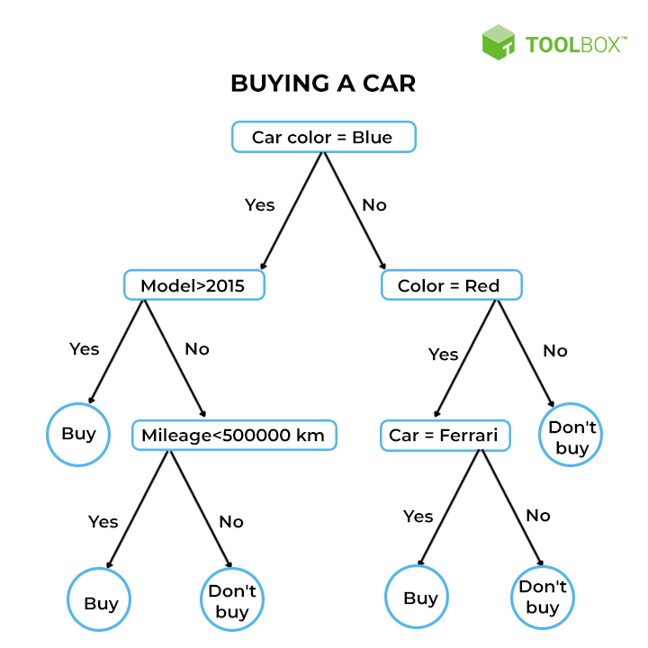
Algorithms
Decision Trees
Description:
A tree-like model for classification and regression. Splits data into branches to make predictions.
Example:
Classifying defects in manufacturing processes.
Notes:
https://towardsdatascience.com/how-big-is-big-data-3fb14d5351ba https://www.mckinsey.com/industries/metals-and-mining/how-we-help-clients/how-a-steel-plant-in-india-tapped-the-value-of-data-and-won-global-acclaim#/

Slide 19
Algorithms
Decision Trees
Description:
A tree-like model for classification and regression. Splits data into branches to make predictions.
Example:
Classifying defects in manufacturing processes.
Notes:
https://towardsdatascience.com/how-big-is-big-data-3fb14d5351ba https://www.mckinsey.com/industries/metals-and-mining/how-we-help-clients/how-a-steel-plant-in-india-tapped-the-value-of-data-and-won-global-acclaim#/

Slide 20
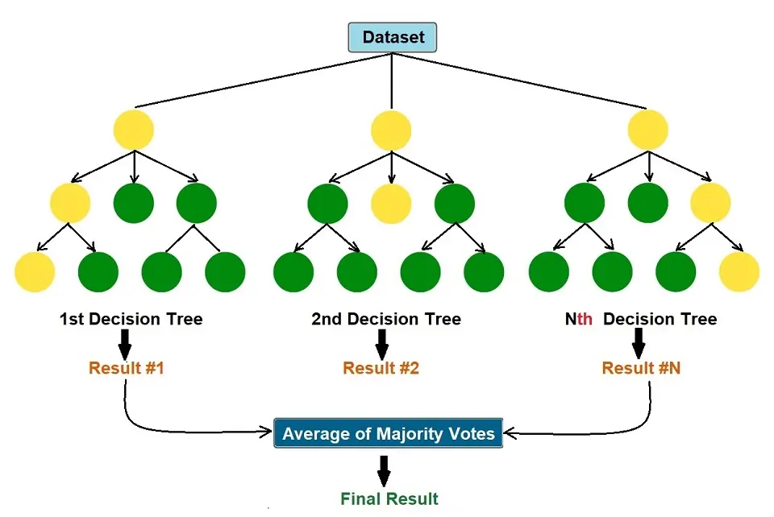
Algorithms
Random Forests
Description:
An ensemble method using multiple decision trees to improve performance and reduce overfitting.
Example:
Predicting equipment failure using sensor data.
Notes:
https://towardsdatascience.com/how-big-is-big-data-3fb14d5351ba https://www.mckinsey.com/industries/metals-and-mining/how-we-help-clients/how-a-steel-plant-in-india-tapped-the-value-of-data-and-won-global-acclaim#/

Slide 21
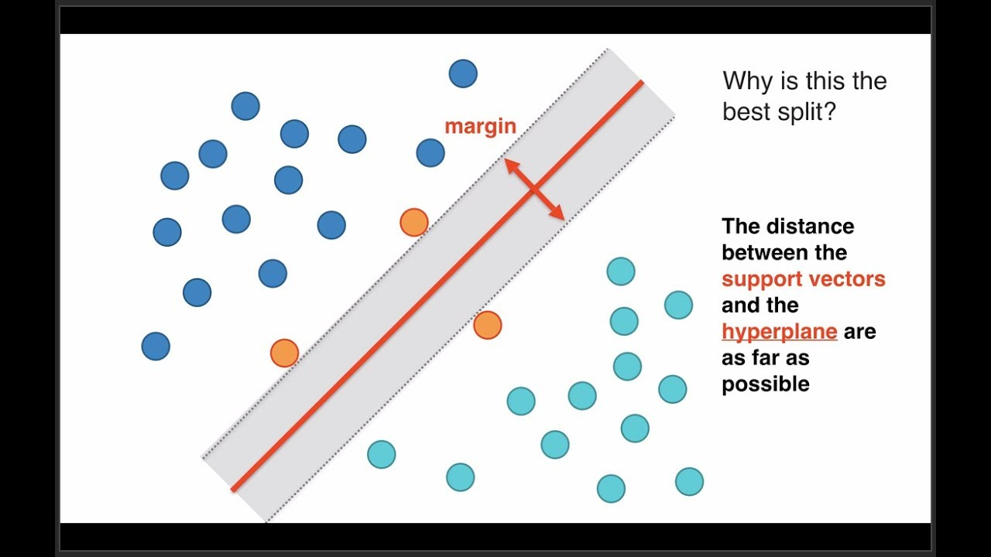
Algorithms
Support Vector Machines (SVMs)
Description:
A classification method that finds the optimal hyperplane to separate different classes.
Example:
Classifying material types based on tensile strength and hardness.
Notes:
https://towardsdatascience.com/how-big-is-big-data-3fb14d5351ba https://www.mckinsey.com/industries/metals-and-mining/how-we-help-clients/how-a-steel-plant-in-india-tapped-the-value-of-data-and-won-global-acclaim#/

Slide 22









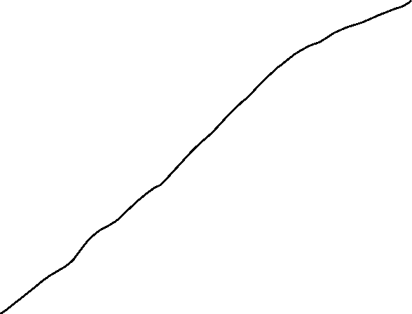
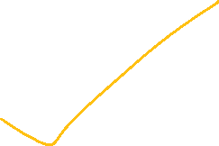


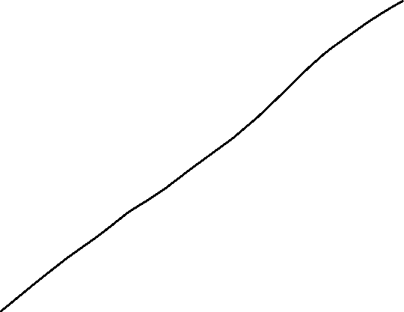
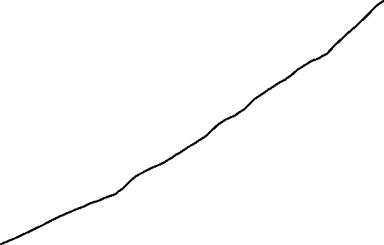






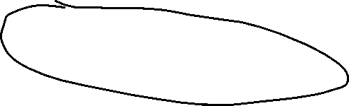
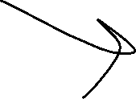





Slide 23
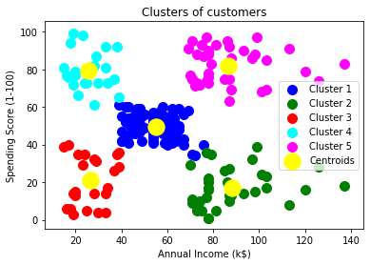
Algorithms
K-Means Clustering
Description:
An unsupervised learning algorithm that partitions data into k clusters based on feature similarity.
Example:
Clustering similar machinery based on performance metrics.
Notes:
https://towardsdatascience.com/how-big-is-big-data-3fb14d5351ba https://www.mckinsey.com/industries/metals-and-mining/how-we-help-clients/how-a-steel-plant-in-india-tapped-the-value-of-data-and-won-global-acclaim#/

Slide 24
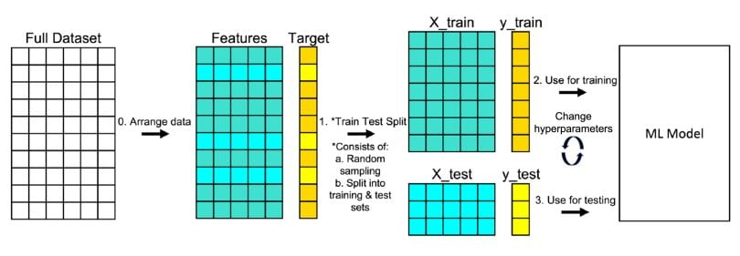
Algorithms
Model Evaluation and Validation
Train-Test Split:
Importance of splitting data into training and testing sets.
Cross-Validation:
K-fold cross-validation for model robustness.
Evaluation Metrics:
Regression: MAE, MSE
Classification: Accuracy, Precision, Recall, F1-Score
Notes:
https://towardsdatascience.com/how-big-is-big-data-3fb14d5351ba https://www.mckinsey.com/industries/metals-and-mining/how-we-help-clients/how-a-steel-plant-in-india-tapped-the-value-of-data-and-won-global-acclaim#/

Slide 25
Algorithms
Model Evaluation and Validation
Train-Test Split:
Importance of splitting data into training and testing sets.
Cross-Validation:
K-fold cross-validation for model robustness.
Evaluation Metrics:
Regression: MAE, MSE
Classification: Accuracy, Precision, Recall, F1-Score
Notes:
https://towardsdatascience.com/how-big-is-big-data-3fb14d5351ba https://www.mckinsey.com/industries/metals-and-mining/how-we-help-clients/how-a-steel-plant-in-india-tapped-the-value-of-data-and-won-global-acclaim#/

Slide 26
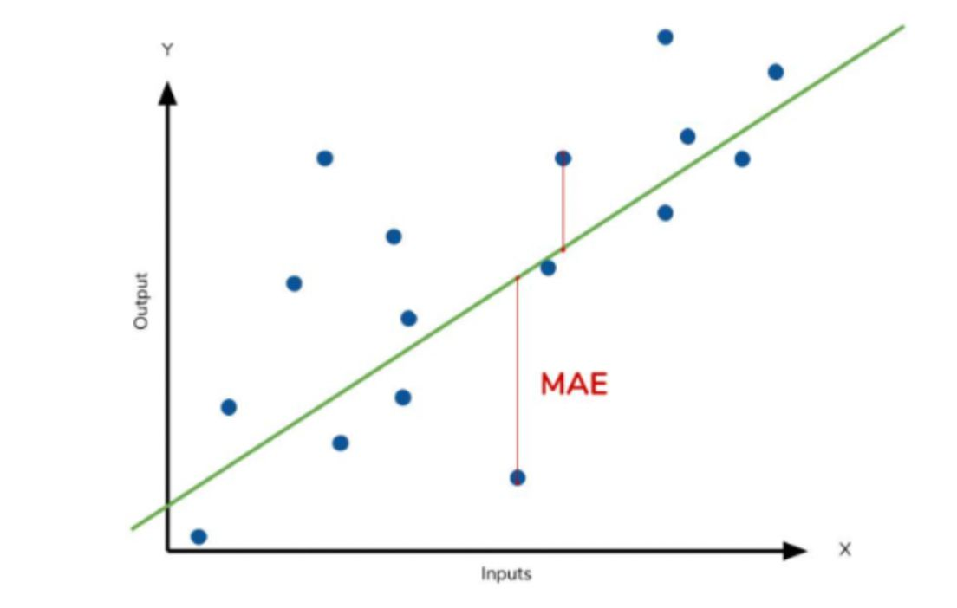
Algorithms
Model Evaluation and Validation
Train-Test Split:
Importance of splitting data into training and testing sets.
Cross-Validation:
K-fold cross-validation for model robustness.
Evaluation Metrics:
Regression: MAE, MSE
Classification: Accuracy, Precision, Recall, F1-Score
Notes:
https://towardsdatascience.com/how-big-is-big-data-3fb14d5351ba https://www.mckinsey.com/industries/metals-and-mining/how-we-help-clients/how-a-steel-plant-in-india-tapped-the-value-of-data-and-won-global-acclaim#/

